Slide 1
Gilbert Paterson
PowerSchool Option Course Selection

Slide 2
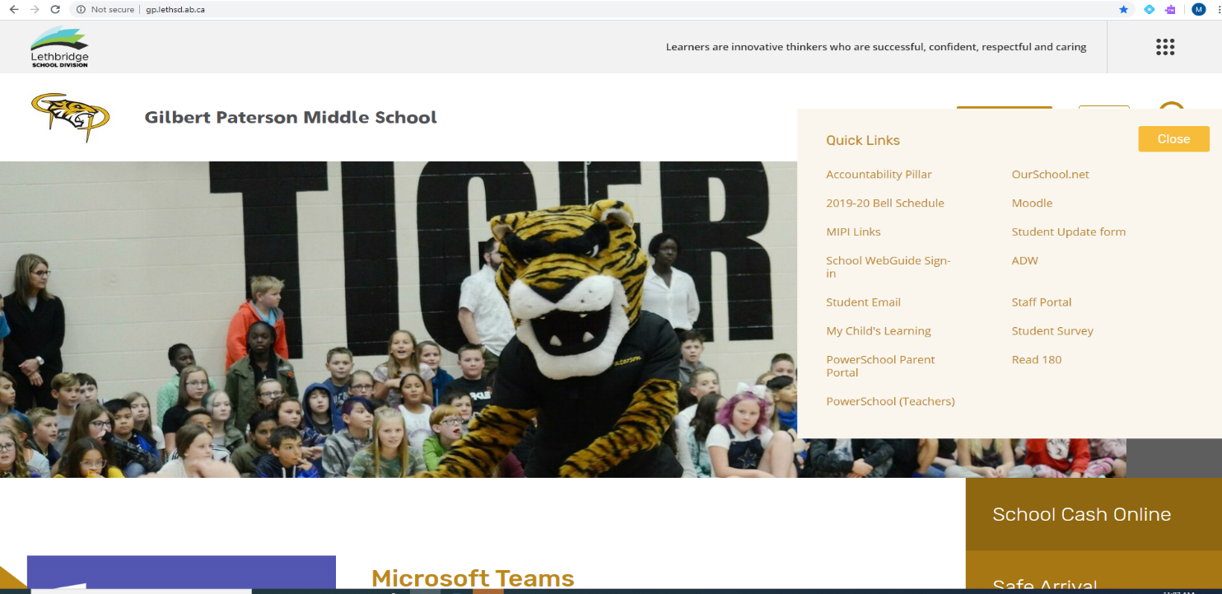
Log on to PowerSchool
1. Go to our school’s website : gp.lethsd.ab.ca
2. Click Quick Links at the top of the page. Then find PowerSchool Parent Portal and click on that.
If you need help, please call 403-329-0125.
Our wonderful office staff will be happy to help!

Slide 3
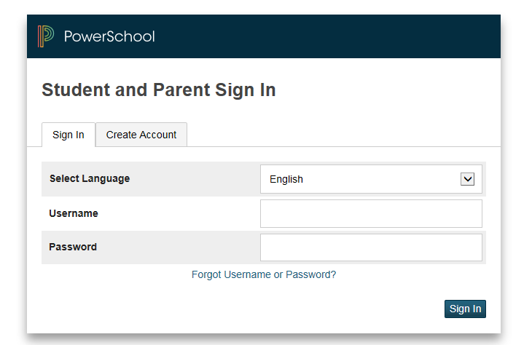
Logging into PowerSchool
Log into the screen using your ID and password.
If you need help, please call 403-329-0125.
Our wonderful office staff will be happy to help!

Slide 4
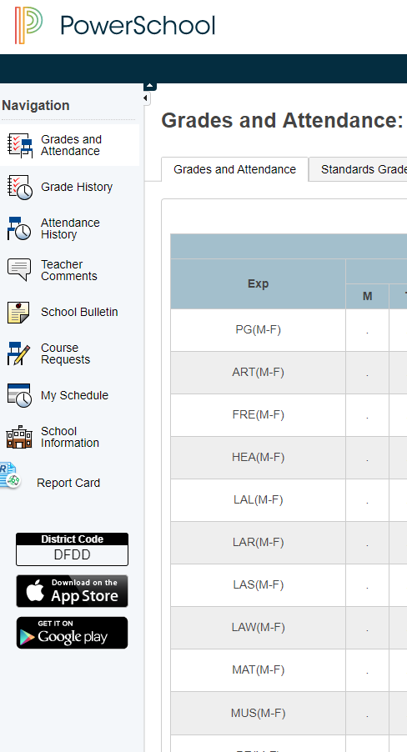
Select Class Registration
From the list on the left-hand side of the page, click on
If you need help, please call 403-329-0125.Our wonderful office staff will be happy to help!

Slide 5
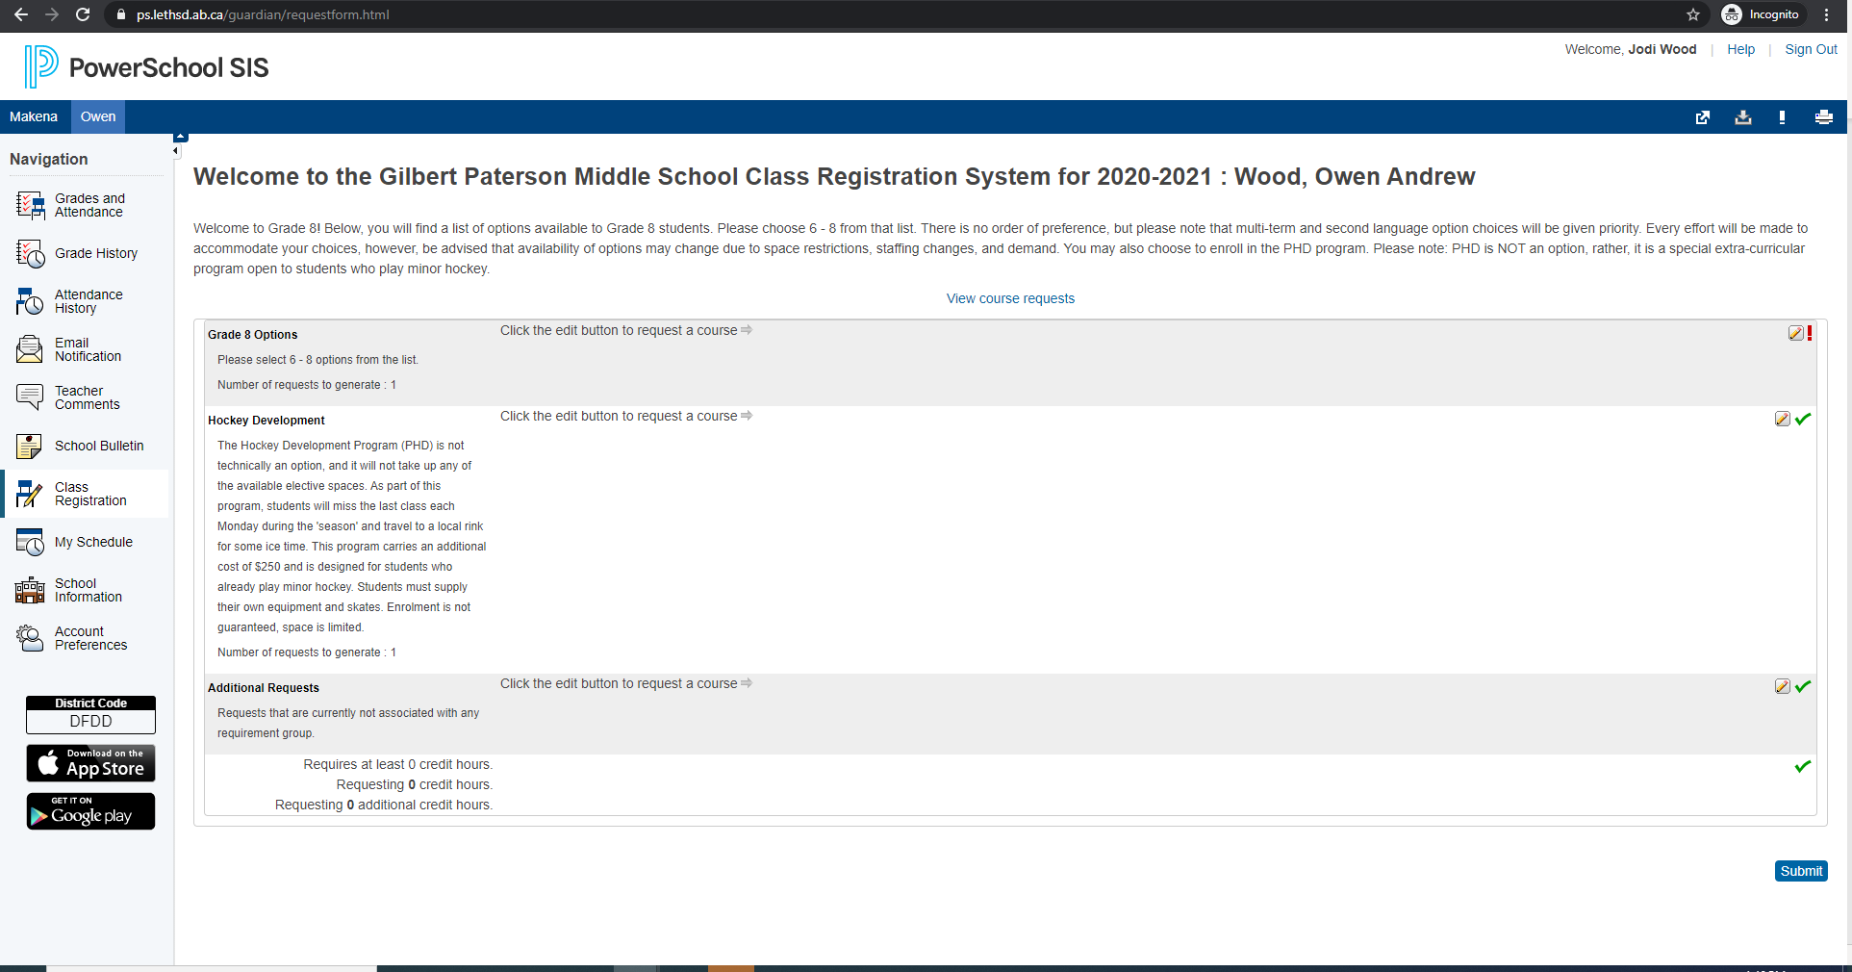
1. On the right-hand side, click on the pencil. The options for each block will show. 2. You do not need to select anything from Additional Requests. If you want to enroll in Paterson Hockey Program, please do it here after you pick your options.
1.
2.

Slide 6
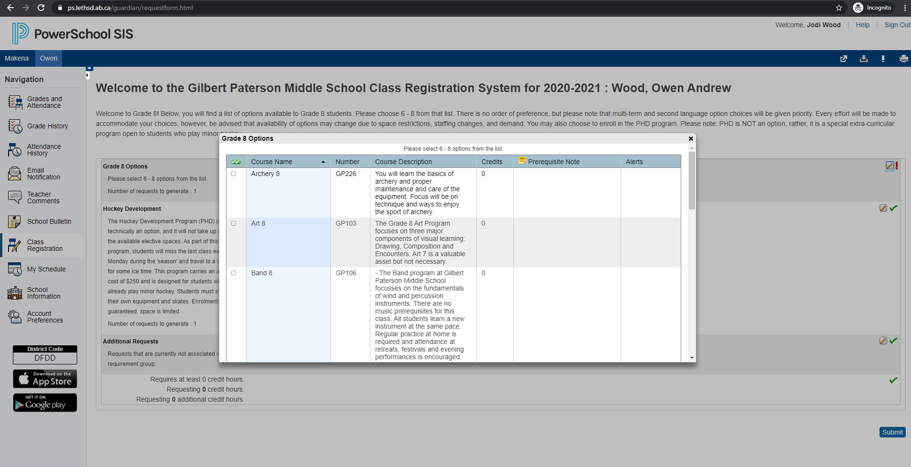
Check boxes to select your choices.
There are three pages of options to choose from!! You need to pick at least 8 term options that interest you. You will not necessarily be guaranteed to get all the options you pick, except for band and choir. Band and choir are full year options will count for three choices. Scroll down and links to the other pages will be at the bottom.

Slide 7
Once you have made your selections, click on okay at the bottom of the screen.
Keep in mind, option requests are not first come, first served. Once all student option requests have been received, our software program works to get every student as many of their requested options as possible. If you’ve selected an option, it means you are interested/willing to take that class. There is no way to indicate preference or priorities.

Slide 8
Once you are happy with your options selections, make sure to click “submit” at the bottom of the main page!!!

Slide 9
You’re done. Your timetable will be ready for you on the first day of school.
If you need help, please call 403-329-0125.
Our wonderful office staff will be happy to help!

