Slide 1


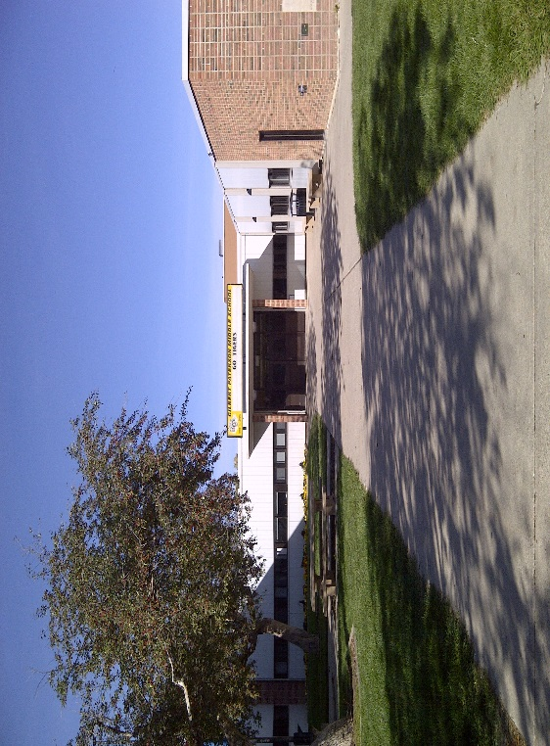
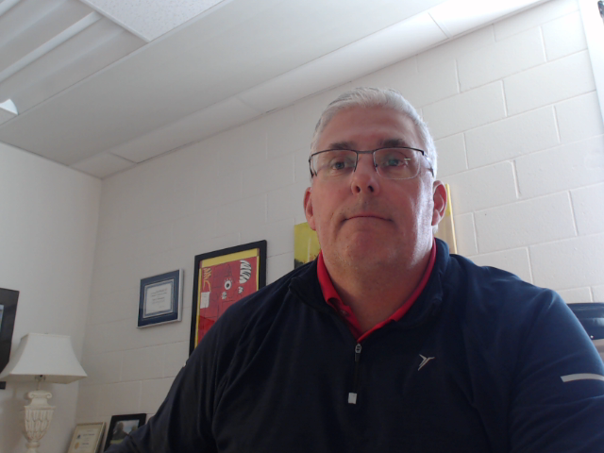
GILBERT PATERSON MIDDLE SCHOOL
2020-21
Welcome to our newest Tigers!
Gilbert Paterson Middle School provides a learning experience that promotes the development of academic, social and emotional, physical and artistic attributes unique to early adolescence.

Slide 2

What makes the transition to grade 6 successful?
Trusting, nurturing relationships with classroom teacher, peers and other adults
Inclusive, caring learning environment
Programs and services to promote and support social / emotional wellness and mindfulness
Wide variety of educational programming to support different levels of literacy / numeracy
Opportunities to explore interests through options, clubs, fine arts, sports and activities

Slide 3
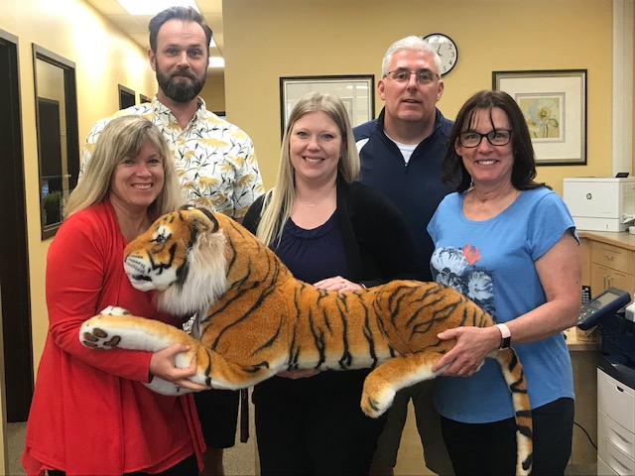
Our Admin / Office Team
Mr. Christiansen
Principal / Gr. 8 Admin
Mr. Brunner
Vice Principal / Gr. 7 Admin
Mme. Thorsen
Vice Principal / Gr. 6 Admin
Mrs. Wilson
Office Administrator
Mrs. Wegner
Office Admin/Front Desk

Slide 4
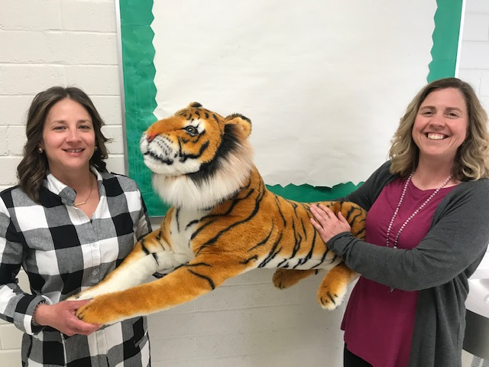
Our Counselling Team
Mrs. Smith – Family School Liaison Counsellor
Ms. Oviatt – Teacher Counsellor
Classroom lessons
Conflict and friendship resolution
Small groups
School wide wellness themes

Slide 5
General Stewart
Lakeview
Agnes Davidson
Fleetwood Bawden
Nicholas
Sheran
2020-21
ENGLISH PROGRAM
3 dyads (6 classrooms)
Math / Science and LA / Social
Teachers in each dyad
FRENCH IMMERSION
1 dyad ( 2 classrooms)
Math / Science and LA / Social
Teachers in each dyad
1 homeroom (4 core classes)

Slide 6
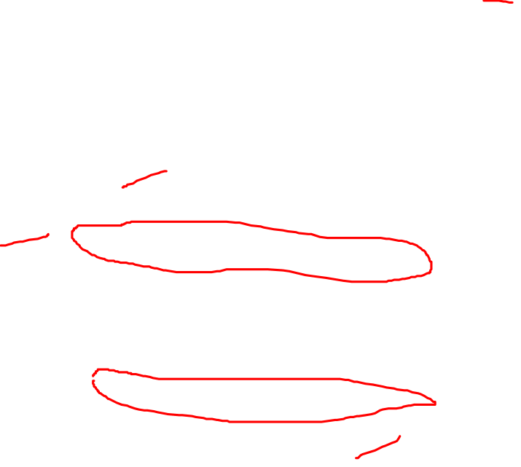
A Grade 6 Week Timetable
Bells Mon-Thur | Monday | Tuesday | Wednesday | Thursday | Friday | Bells Fri
1 8:10-9:00 50mins | MATH | LA | MATH | LA | HEALTH 6 | 1 8:10-9:05
2 9:00-9:50 50mins | LA | MATH | LA | SCI | MATH | 2 9:05-10:00
9:50-9:55 |  |  |  |  |  | 10:00-10:05
3 9:55-10:45 50mins | SCI | PE | SCI | LA | LA | 3 10:05-11:00
4 10:45-11:35 50mins | PE | Codemakers | Codemakers | Codemakers | SS | 4 11:00-12:00
11:35-12:12 40mins | LUNCH | LUNCH | LUNCH | LUNCH
5 12:20-1:20 60mins | DEAR SS | DEAR BAND | DEAR BAND | DEAR BAND
6 1:20-2:10 50mins | MATH | SS | MATH | PE
7 2:10-3:00 50mins | LA | SCI | Collaborative Wednesday (2:10-3:00) | SS

Slide 7
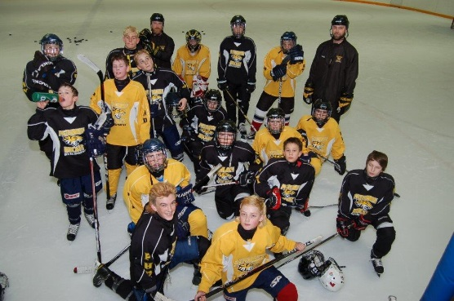
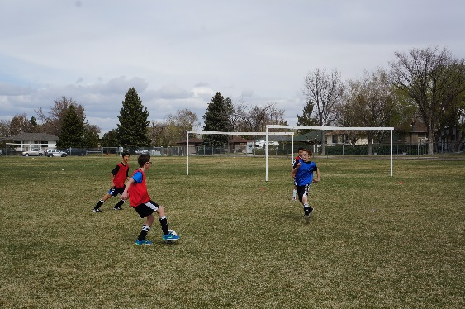
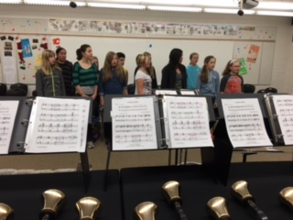
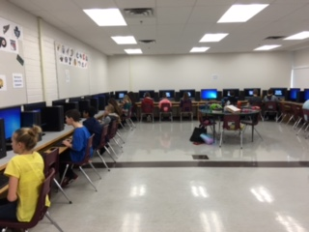
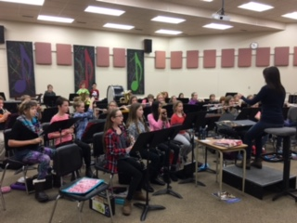
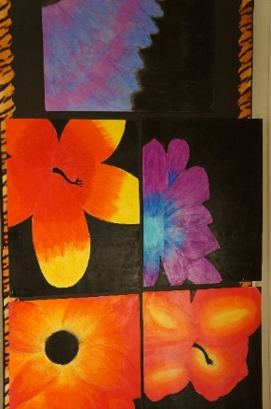
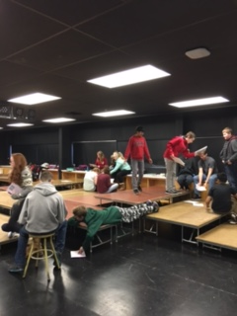
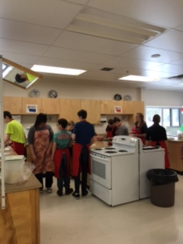
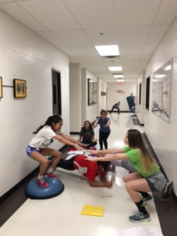
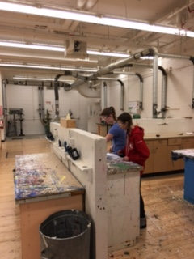
Options

Slide 8

PHD is not an option and does not take up an option space. Please note that space may be limited for grade 6 students.
Complete your option choices in PowerSchool by May 15th
Option choice instructions
Read over the option descriptions in your booklet.
Check out the PowerSchool option selection instructions sent to you on May 8th
You will receive 6 option choices throughout the year.
Full year options fill 3 choices.
If you are not in a full year option, choose 8-10 single term options you are interested in taking.

Slide 9
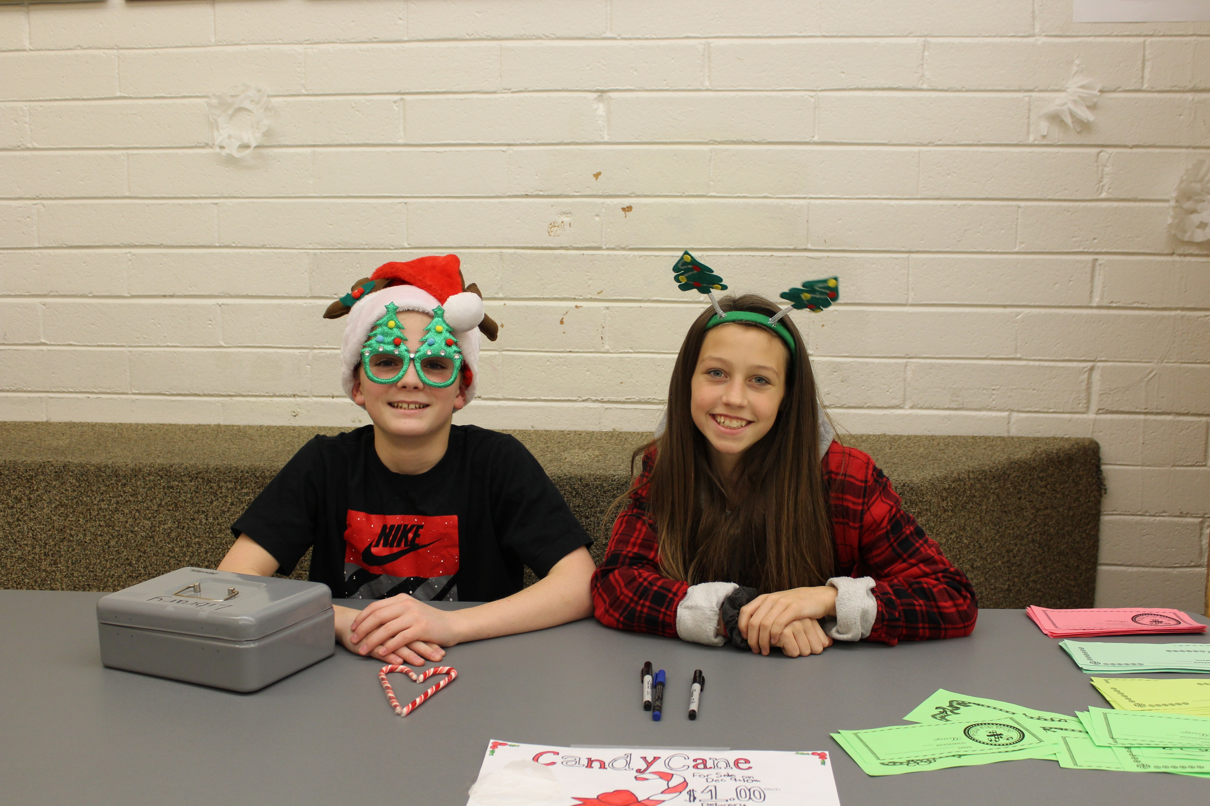
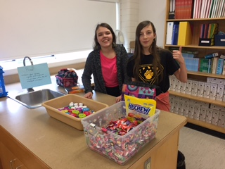
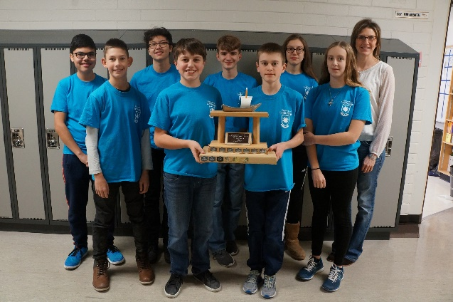
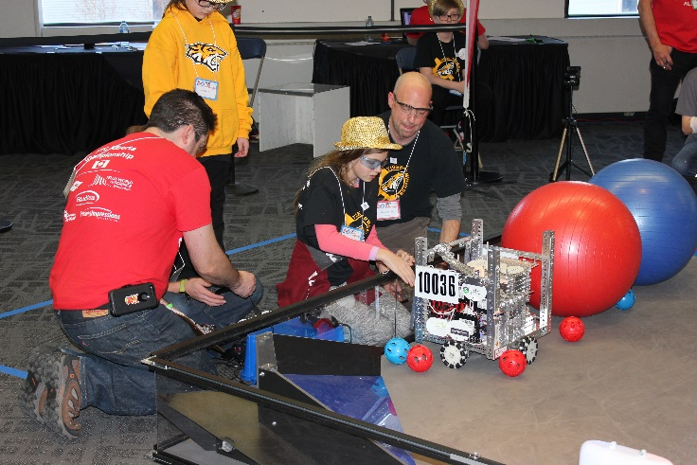
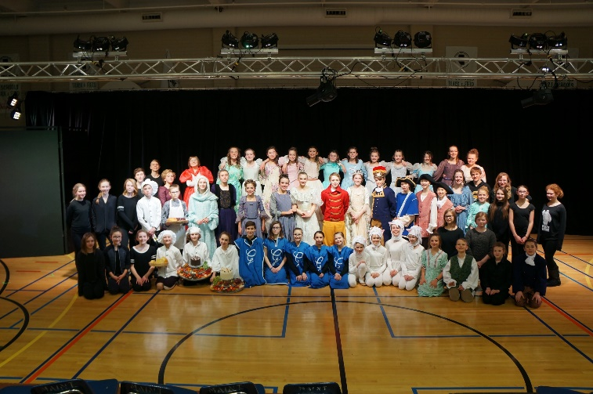
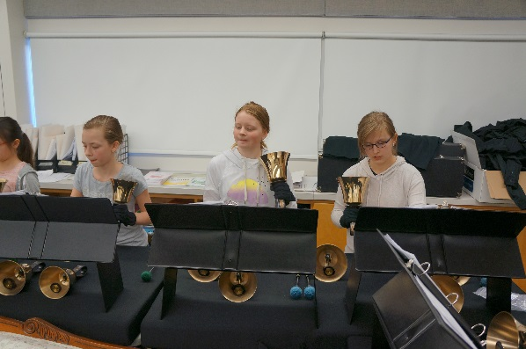
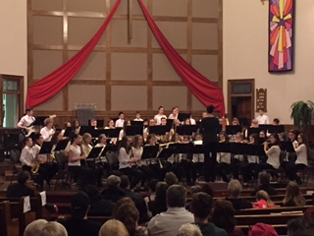
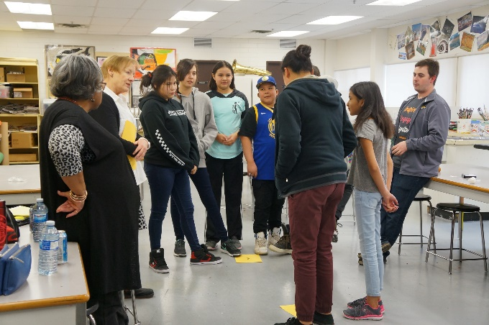
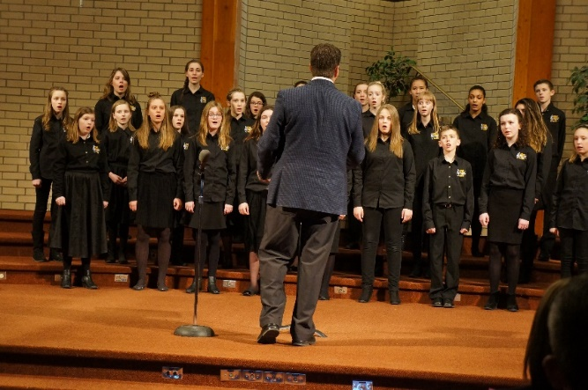
Fine Arts and Clubs

Slide 10
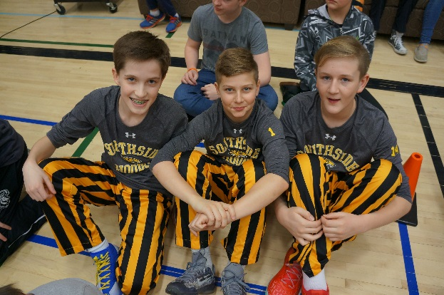
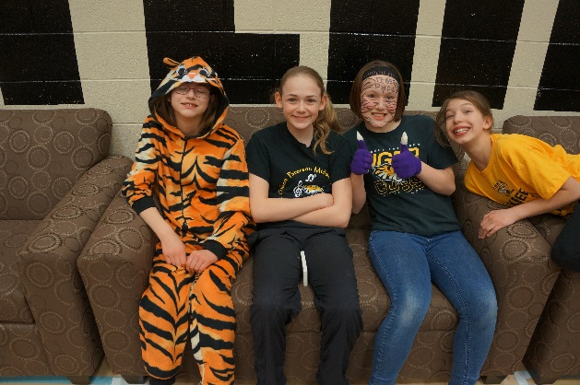
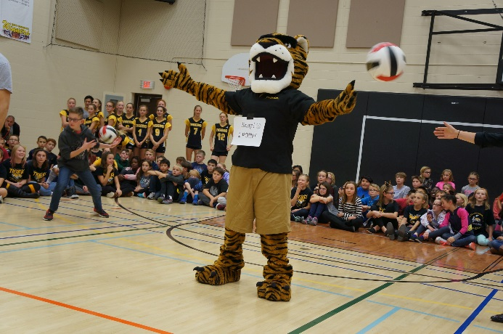
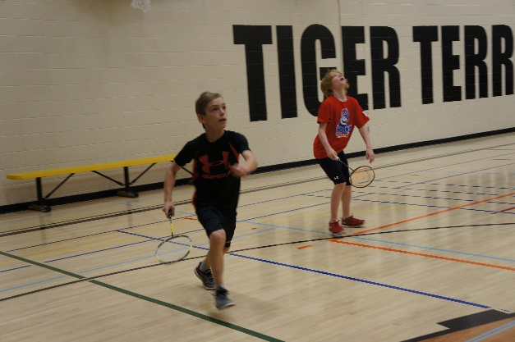
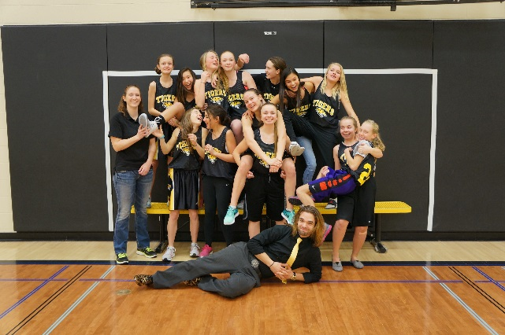
Athletics
Cross Country
Volleyball
Basketball
Badminton
Track & Field

Slide 11

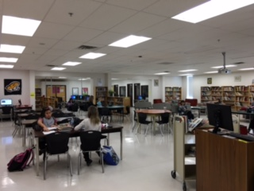
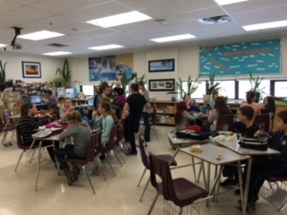
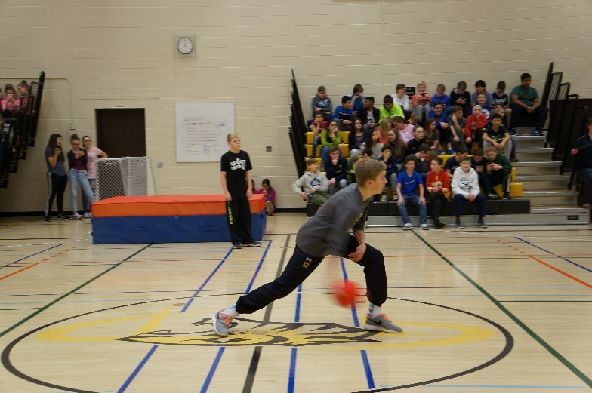
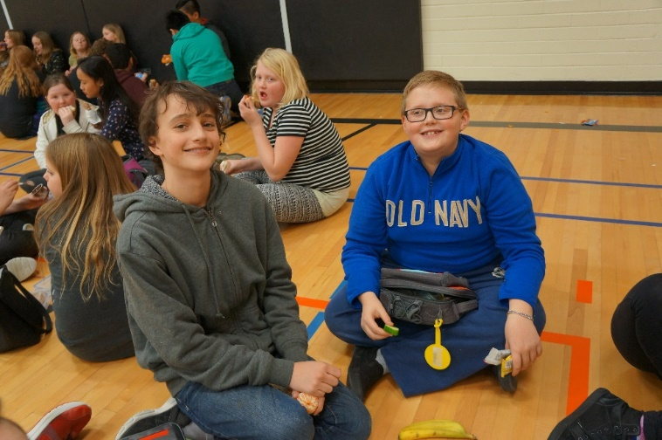
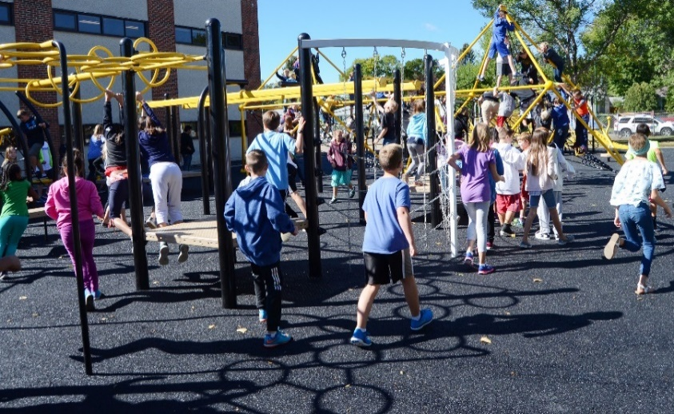
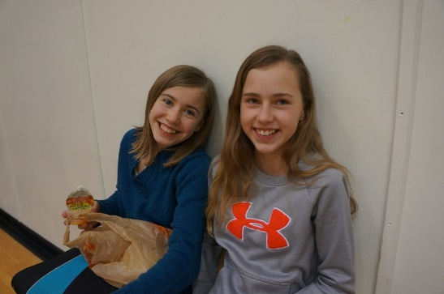
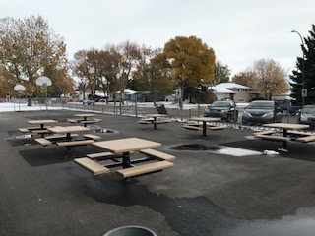
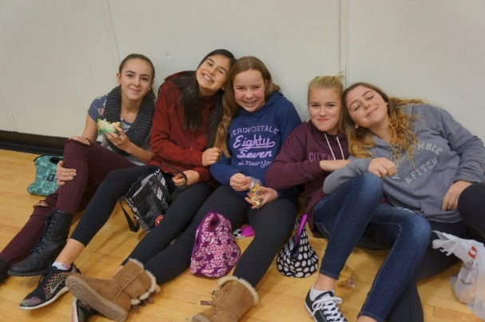
Lunch Hour

Slide 12
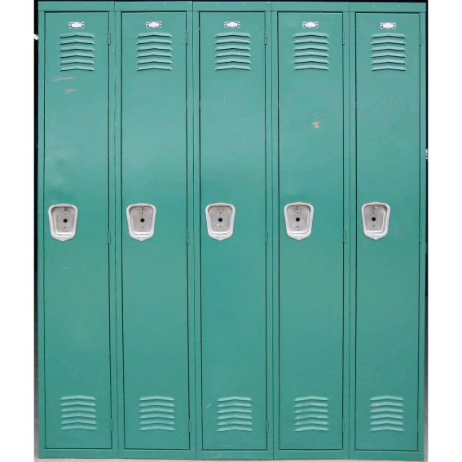
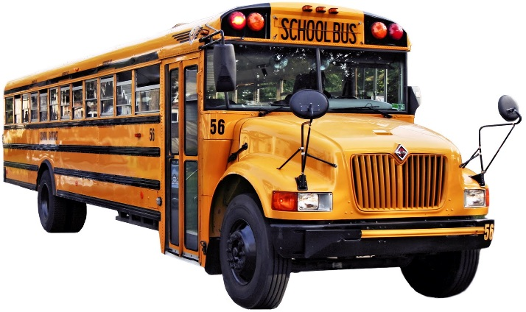



Middle School – It’s all new…
Lockers
Busses
Lunch time
Homework
Questions?
It’s not scary!

Slide 13
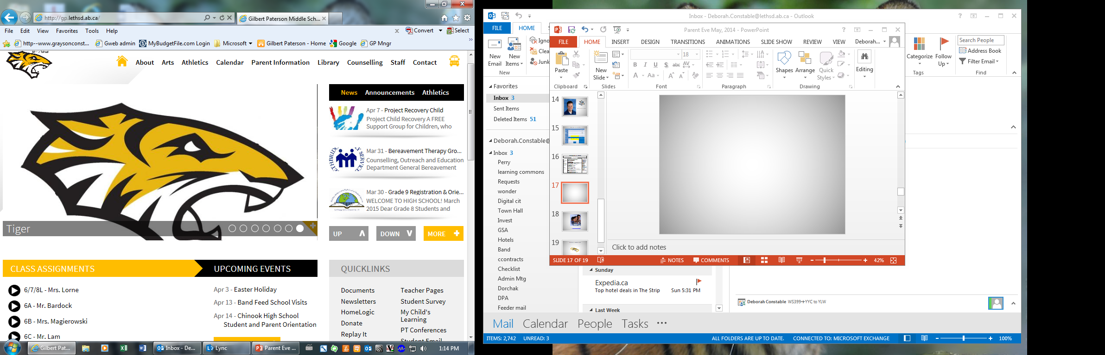
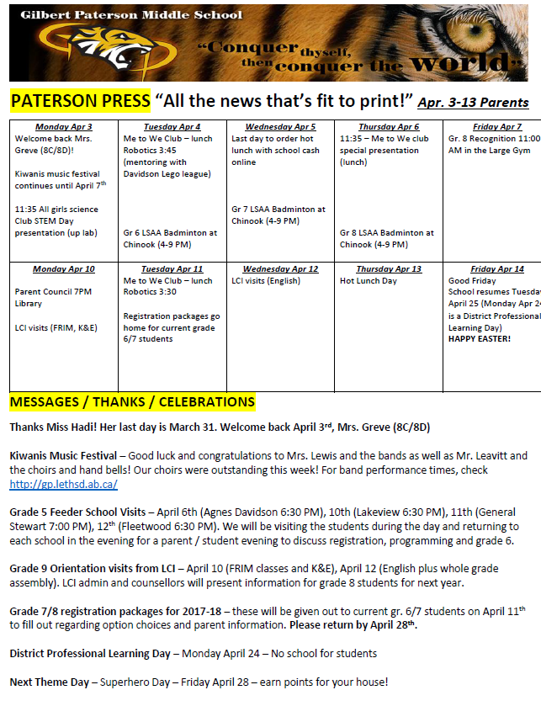

Home Communication
Follow us on Twitter
@GilbertPaterson

Slide 14

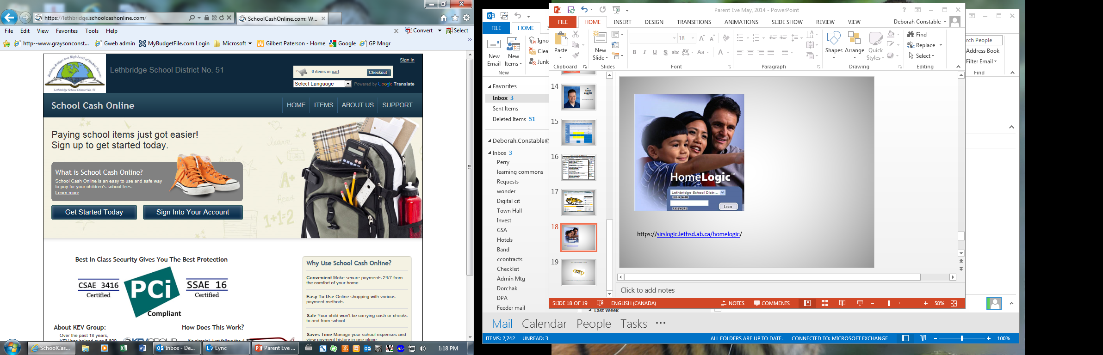

Communication – Marks, Attendance & Fees
PowerSchool – marks, attendance
School Cash Online – all school purchases and fees
School Connects – Safe Arrival – online attendance and app

Slide 15
First Day
Tuesday Sept 1, 2020
Welcome
Bienvenue
8:00 – 8:10 - Grade 6 students arrive through front door. Grade 7/8
students will arrive after lunch.
8:10 – 8:30 - Grade 6 students go to the small gym where they will
find out who their teacher is and start their day!
8:30 – 10:45 - Grade 6 students will get their timetables, lockers and
tour the school to see where their classes are. They will
spend time in their dyads and meet new classmates
and school staff.
10:45 - 11:30 - Grade 6 opening day kick off assembly!
11:35-12:10 - Grade 6 – Lunch – Small gym – after lunch, students
continue their day in their grade 6 dyads.
12:20 - Grade 7/8 students arrive for lockers / timetables, etc.
2:00-2:50 - School wide first day assembly
3:00 - All students are dismissed. Busses do run for those
that qualify. http://www.lethsd.ab.ca/
All classes begin on Wednesday!

Slide 16
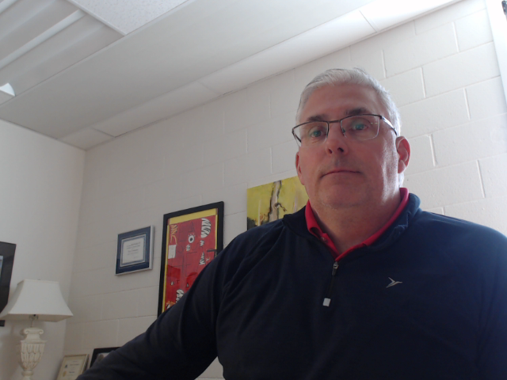
GILBERT PATERSON MIDDLE SCHOOL
Gilbert Paterson Middle School provides a learning experience that promotes the development of academic, social and emotional, physical and artistic attributes unique to early adolescence

